Slide 1
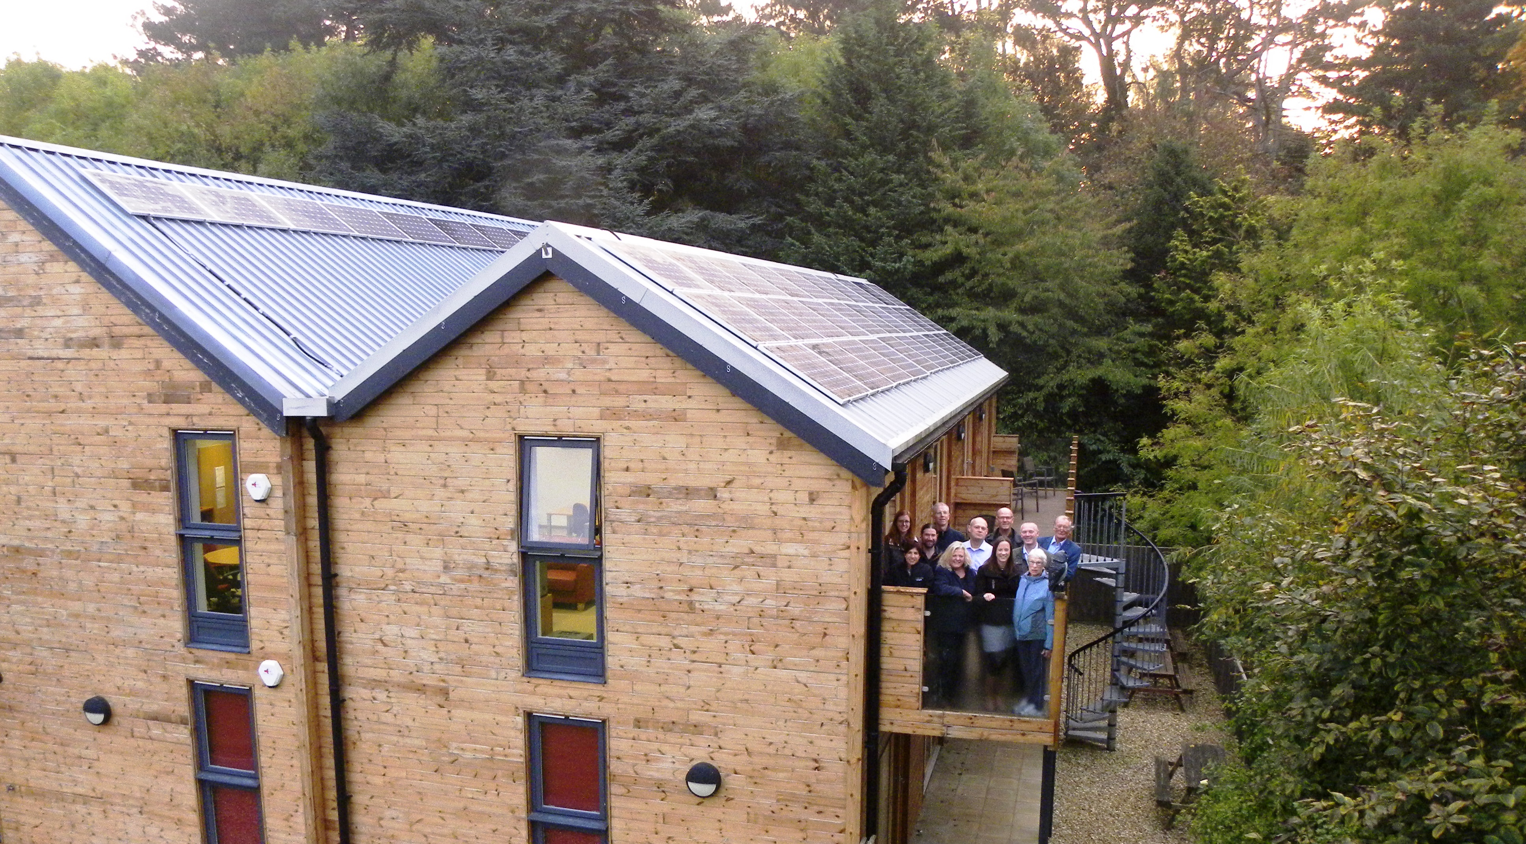
Harborough Solar One
Annual General Meeting 2018

Slide 2
Harborough Solar One
Annual General Meeting 2018
Welcome and Introductions Darren Woodiwiss Project One Financial update Gavin Fletcher Project One Solar PV performance David Robins Project Two overview Gavin Fletcher Annual General Meeting Formalities

Slide 3
Harborough Solar One Financials
Cash at bank 1st August 2017 - £21,305.36
Income | Predicted | Actual | Income Difference
Feed in Tariff + Export Tariff | £4181 | £4294.40 | £113.40
Power Sales | £4945 | £4051.94 | -£893.06
VAT repay | £0 | £1.76 | £1.76
Sub total | £9126 | £8348.10 | -£777.90
Expenditure |  |  | Expenditure Difference
Insurance | £928 | £924 | £4
Equipment costs | £0 | £643.20 | -£643.20
VAT | £0 | £560.81 | -£560
Investor interest payments | £4425 | £4417.5 | £7.50
FCA payment | £902 | £205 | £697
Harborough Energy Repay | £5000 | £5000 | £0
Sub total | £11255 | £11750.51 | -£494.70
Total | -£2129 | -£3402.41 | -£1272.60
Cash at bank at 31st July 2018 – £17,902.95

Slide 4
Harborough Solar One
Project 1 - Solar PV Output

Slide 5
Harborough Solar One – Project 1
Solar PV Output
Your installations at Woodnewton Academy and Archway House have generated 113,000 KWh* of clean electricity since they were installed in AUG/SEP 2016 - saving an equivalent of 51 Tonnes of CO2
* As at 19AUG18 - based on data from The Energy Meter Information Gateway (eMIG)
Host Site Output (Started) | Woodnewton Roof 1&2 (24AUG16) | Woodnewton Roof 3 (30AUG16) | Woodnewton Roof 4 (26AUG16) | Archway House (27SEP16) | HS1 P1 Total for Year (kWh) | Variance on Previous Year (avg)
AUG16-JUL17 | 14,945 | 15,764 | 12,682 | 6,897 | 50,288 | -
AUG17-JUL18 | 16,960 | 18,284 | 14,688 | 8,821 | 58,753 | +3% (Pro Rata Estimate)

Slide 6
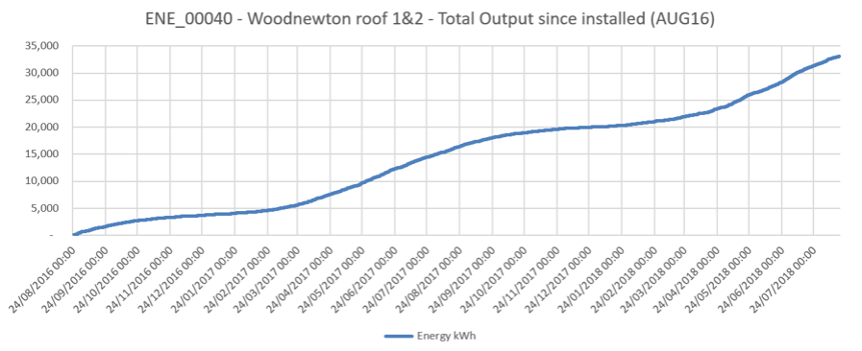
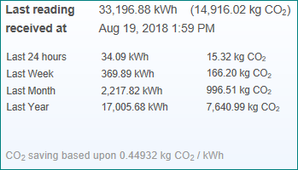
HOW ARE WE PERFORMING?
WOODNEWTON ROOF 1&2 – To Date

Slide 7
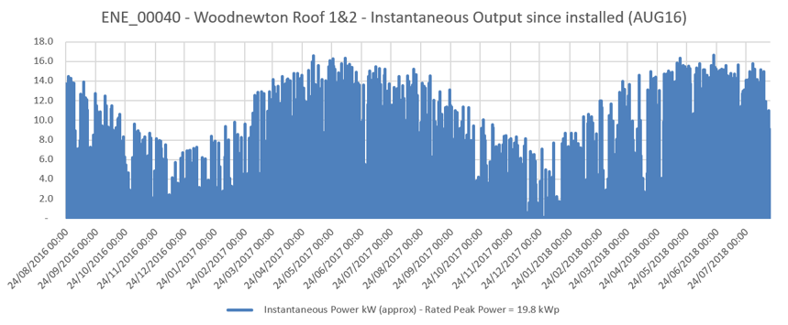
HOW ARE WE PERFORMING?
WOODNEWTON ROOF 1&2 – To Date

Slide 8
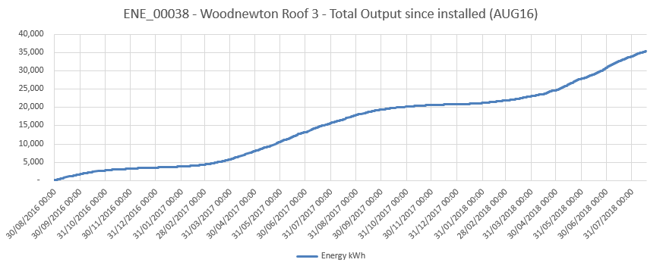
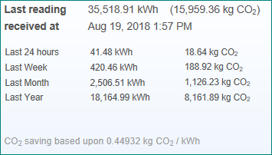
HOW ARE WE PERFORMING?
WOODNEWTON ROOF 3 – To date

Slide 9
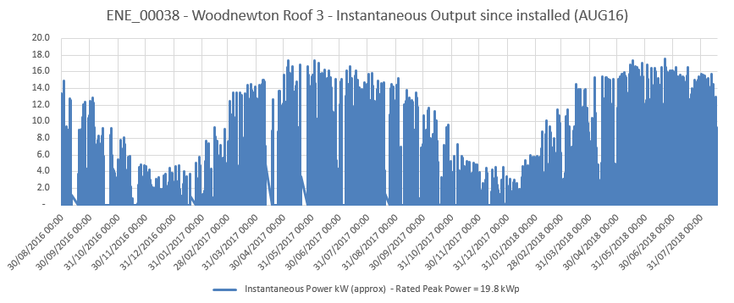
HOW ARE WE PERFORMING?
WOODNEWTON ROOF 3 – To date

Slide 10
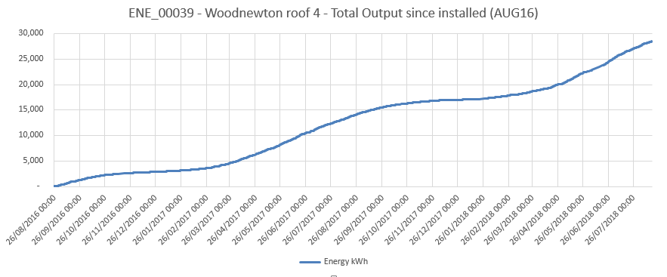
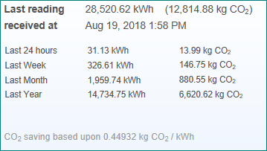
HOW ARE WE PERFORMING?
WOODNEWTON ROOF 4 – To Date

Slide 11
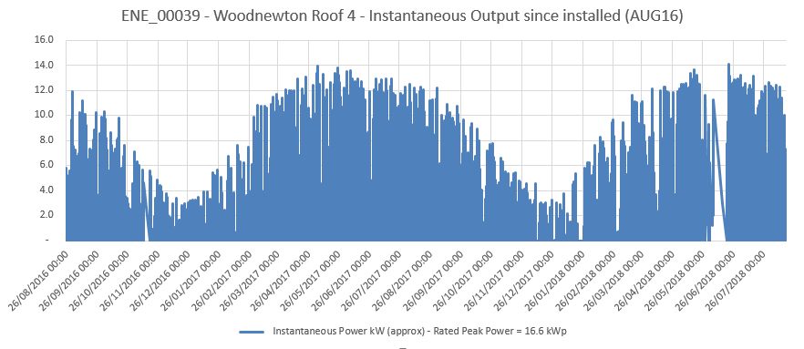
HOW ARE WE PERFORMING?
WOODNEWTON ROOF 4 – To Date

Slide 12
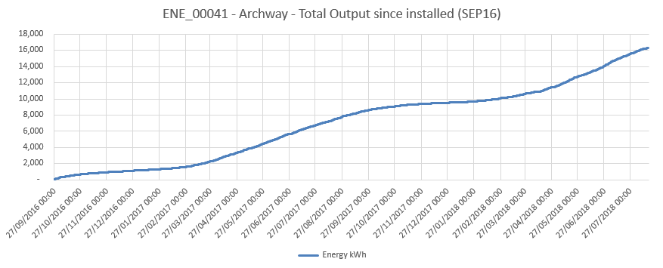
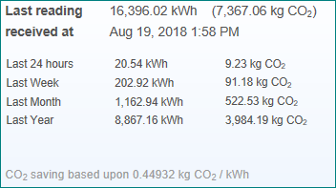
HOW ARE WE PERFORMING?
ARCHWAY HOUSE – To Date

Slide 13
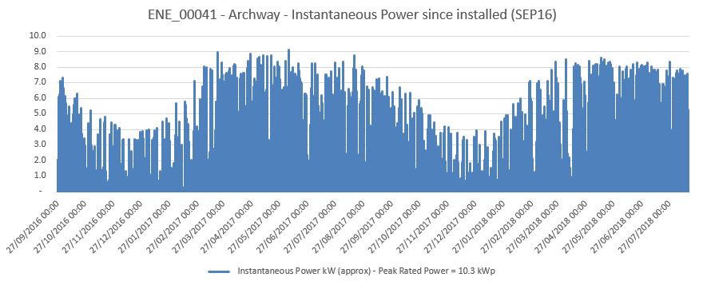
HOW ARE WE PERFORMING?
ARCHWAY HOUSE – To Date

Slide 14
Harborough Solar One
Project 2
Amount raised through share offer - £99,000
Number of investors – 45 (29 in Leicestershire or Northamptonshire)
Size of PV array – 102.6 kW
Number of PV panels – 360 at 285W peak output
Cost of system - £100,671
Cost of share raise fees - £5980
Investment from HS1 bank account - £7,651
51 tonnes of CO2 savings per year
95,931 kWh generated per year (depending on the weather!)
Projected community benefit fund of £37,000 over the life of the project

Slide 15
Harborough Solar One
AGM Formalities
Nominations and appointment of the Board of Directors
Receipt of the Accounts
Investor returns
Community Benefit – Discussion
Close

